Slide 1
Washington State Opioid Awareness Campaign
Washington State Opioid Awareness Campaign

Slide 2
Introduction to Medications for the Treatment of Opioid Use Disorder
Jessica K. Blose
Washington State Opioid Treatment Authority
Health Care Authority

Slide 3
Introduction to MAT
Your Name
Organization

Slide 4
What is “MAT”?

Slide 5
“Medication-Assisted Treatment (MAT) is the use of FDA-approved medications, in combination with counseling and behavioral therapies, to provide a ‘whole-patient’ approach to the treatment of substance use disorders.”
As per Substance Abuse and Mental Health Services Administration (SAMHSA)

Slide 6
There are FDA approved medications for the treatment of the following substance use disorders:
Opioid
Alcohol
Tobacco

Slide 7
FDA approved medications to treat Opioid Use Disorder (OUD)

Slide 8
Methadone
Opioid agonist.
Prevents opioid withdrawal symptoms and cravings when a client takes it.
Does not block the effects of other narcotics if client relapses.
Available in liquid or pill form.
Dispensed only in specialty regulated clinics.
Considered a Schedule II Controlled Substance

Slide 9
Buprenorphine Products
Partial opioid agonist/antagonist.
Prevents opioid withdrawal symptoms and cravings.
Blocks the effects of other narcotics if client relapses.
Available as sublingual film, pill form, as a 6-month implant under the skin or as a monthly injectable form.
Can be offered in any medical setting that has a DATA 2000 waived prescriber.
Considered a Schedule III controlled substance.

Slide 10
Naltrexone
Opioid antagonist.
Blocks the effects of other narcotics if client relapses.
Available in daily pill or monthly injection form.
Can be offered in any medical setting.
Not considered a controlled substance.

Slide 11
The Opioid Crisis in Tribal Communities

Slide 12
Opioid overdose deaths are rising among American Indians and Alaska Natives (AI/AN)
The overdose death rate for AI/AN individuals has increased dramatically:
In 1999, the nationwide overdose death rate was 2.9 deaths per 100,00 AI/AN individuals.
By 2016, the overdose death rate had risen to 13.9 deaths per 100,00 AI/AN individuals.
Some of the highest AI/AN OUD overdose death rates are occurring in the Pacific Northwest.

Slide 13
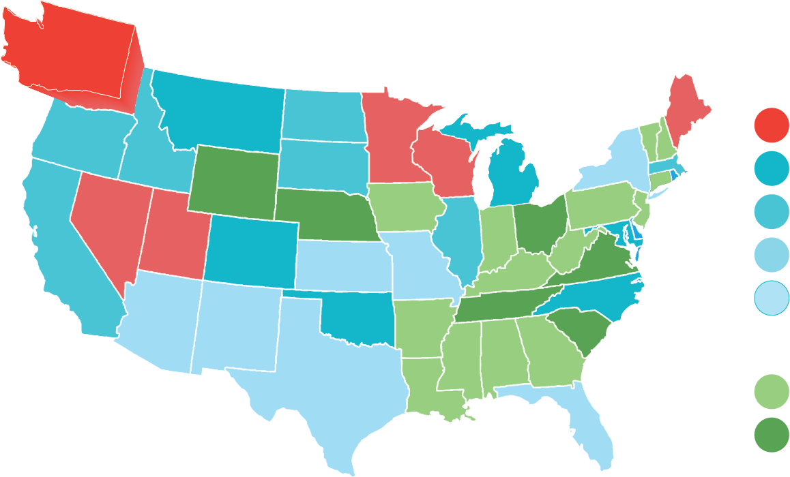
AI/AN Opioid Overdoses by State
>12.5 to 22.3
>9.2 to 12.1
>6.0 to 9.1
2.6 to 5.8
Other
Suppressed value
Unreliable value
1999-2016 Opioid Overdose Age-adjusted Mortality Rates for AI/AN
National Center for Health Statistics, Centers for Disease Control and Prevention, U.S. Department of Health and Human Services, “Multiple Cause of Death 1999-2015 on CDC WONDER Online Database, released 2016,” Available through <https://wonder.cdc.gov/controller/datarequest/D77> (last visited January 17, 2018).

Slide 14
Is using medication for the treatment of opioid use disorder effective?

Slide 15
Challenging the Myths About Medication for the Treatment of opioid use disorder.

Slide 16
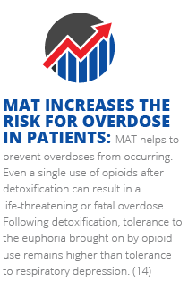
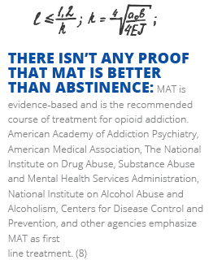
Challenging the Myths About Medication for the Treatment of opioid use disorder.

Slide 17
Evidence of effectiveness
The science demonstrating the effectiveness of medication for Opioid use disorder is strong. For most individuals, the use of medications, combined with psychosocial treatment results in better outcomes than psychosocial treatment on its own.
“Studies have repeatedly demonstrated the efficacy of MAT at reducing illicit drug use and overdose deaths, improving retention in treatment, and reducing HIV transmission.”
Supporting development, access and adoption of medications for the treatment of opioid use disorder should be a key priority for any program serving clients with opioid use disorder.
Source: The Surgeon General’s 2016 report, Facing Addiction In America

Slide 18
Thank you.
Jessica K. Blose
Washington State Opioid Treatment Authority
Health Care Authority

Slide 19
Thank you.
Your Name
Organization
Telephone:
Email:

